Slide 1
Introduction to Unity
CaramelYo

Slide 2
Outline
Before Class
Introduction
Component Behavior
Component-oriented Design
Using Package
Notice
Homework
Next Class

Slide 3
Outline
Before Class

Slide 4
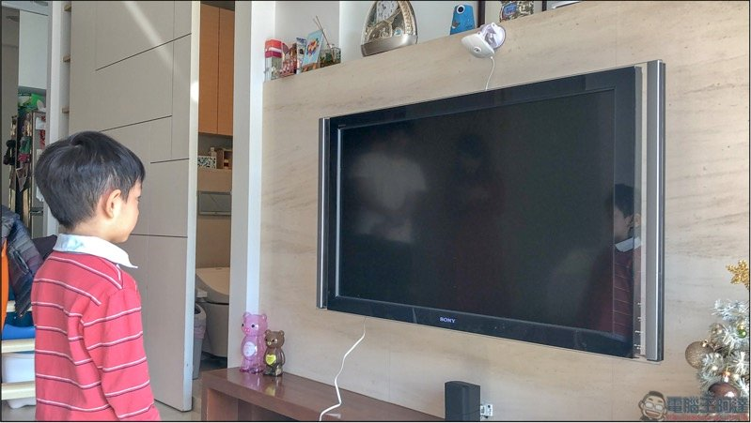
Before Class
Recommendation
Use your own laptop (notebook) in this course (with unity 2020.3.21f1)
Sit closer to lectern as possible as you can

Slide 5
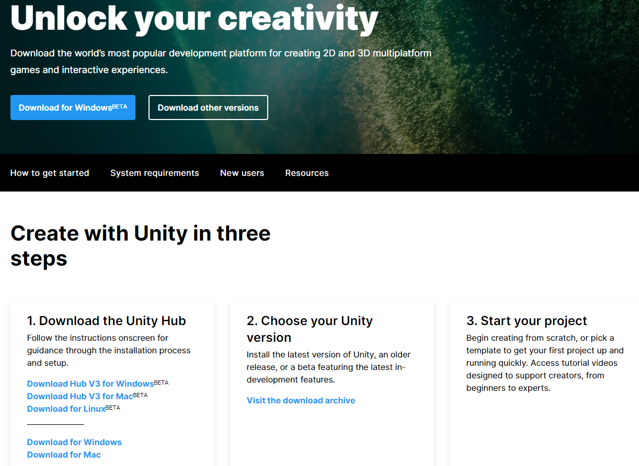
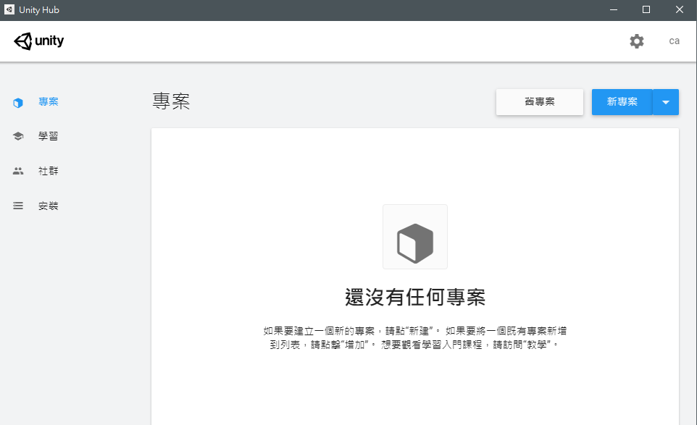
Before Class
Download Unity
Download the Unity Hub and install it：https://unity.com/download#how-get-started

Slide 6
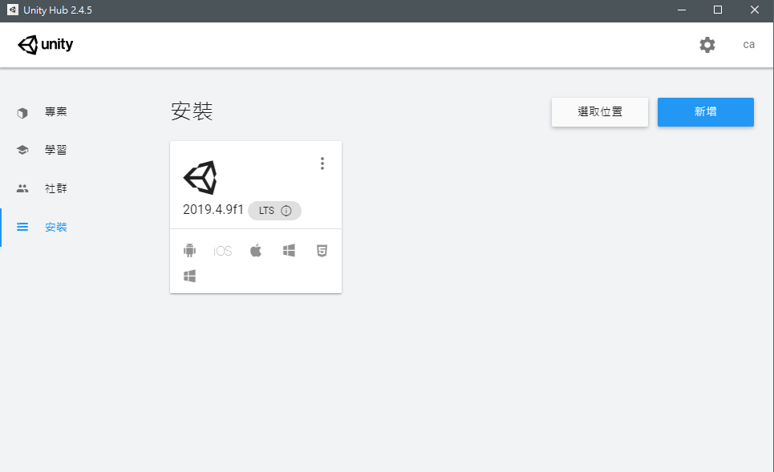
Before Class
Download Unity
Click “install” and “new”

Slide 7
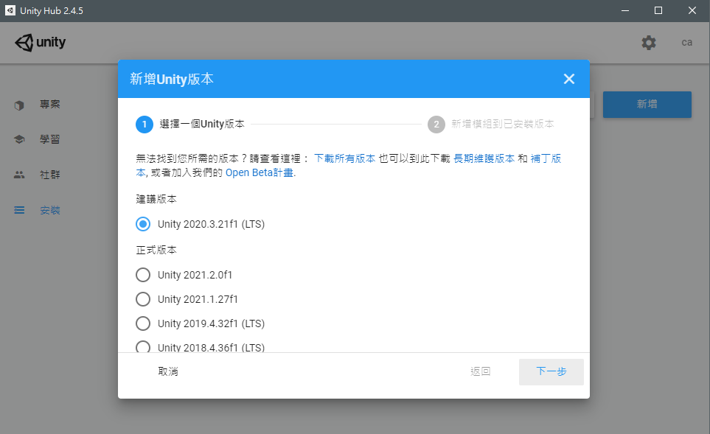
Before Class
Download Unity
Choose the “Unity 2020.3.21f1 (LTS)” (long term support)

Slide 8
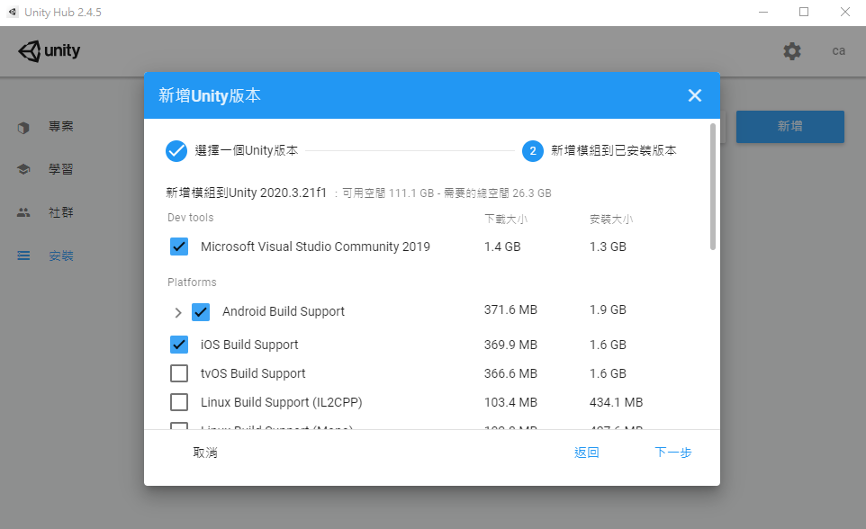
Before Class
Download Unity
Recommend Visual Studio 2019 (VS 2019) by default
We use Visual Studio 2017 as editor, so you don’t need to download VS 2019
No need！
X
Choose those platforms you need

Slide 9
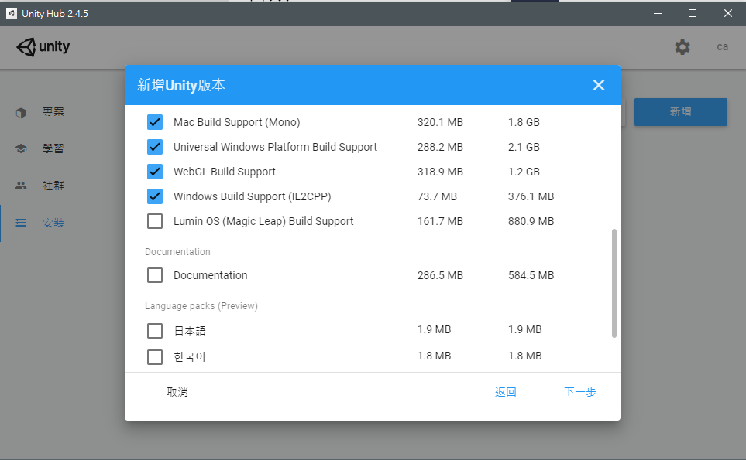
Before Class
Download Unity
Choose those platforms you need

Slide 10
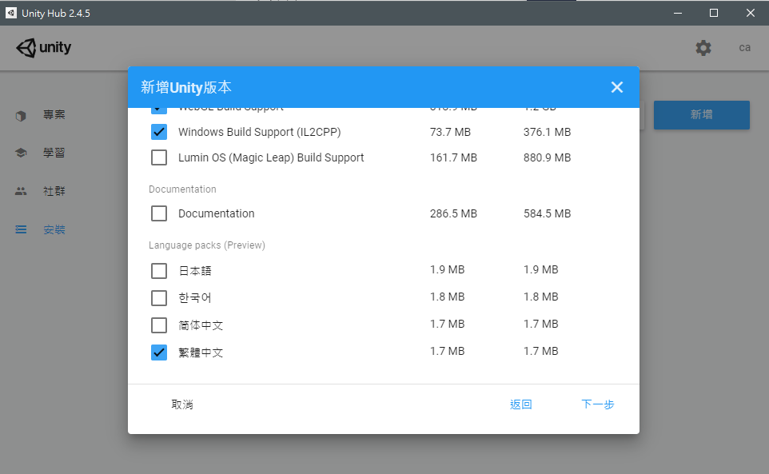
Before Class
Download Unity
Choose the languages you need
Choose the languages you need

Slide 11
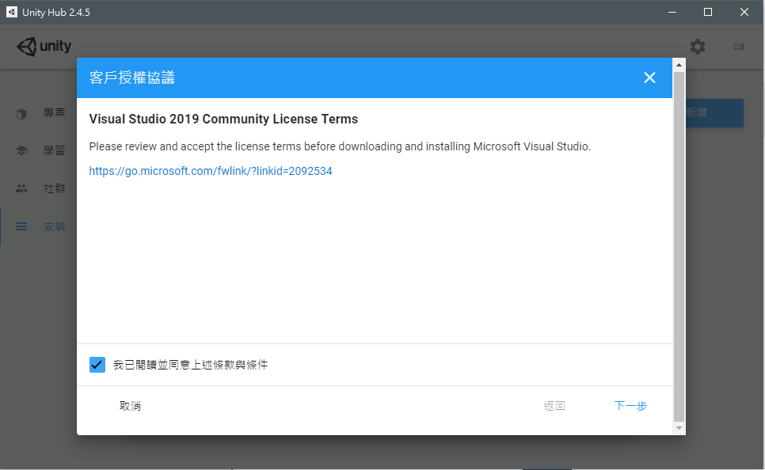
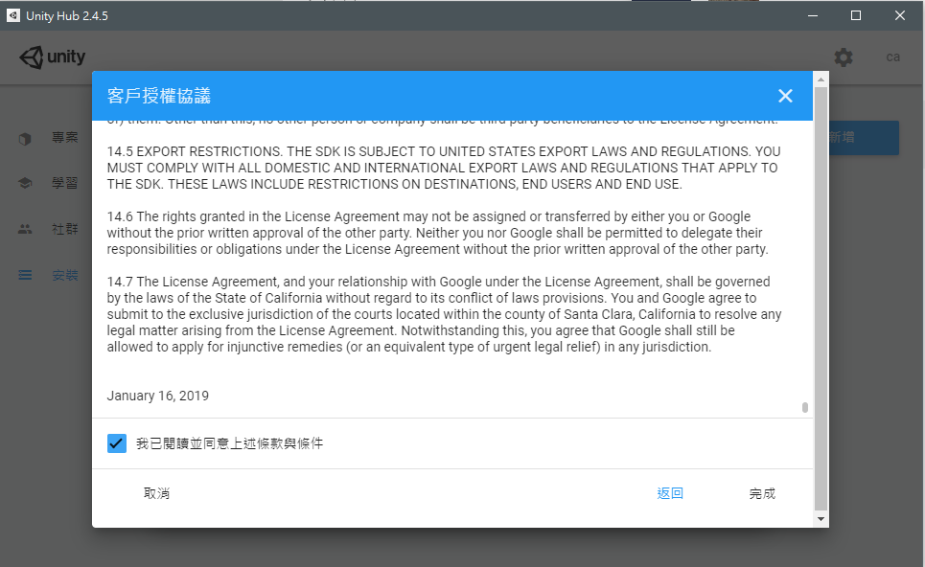
Before Class
Download Unity
Agree all and then install…

Slide 12
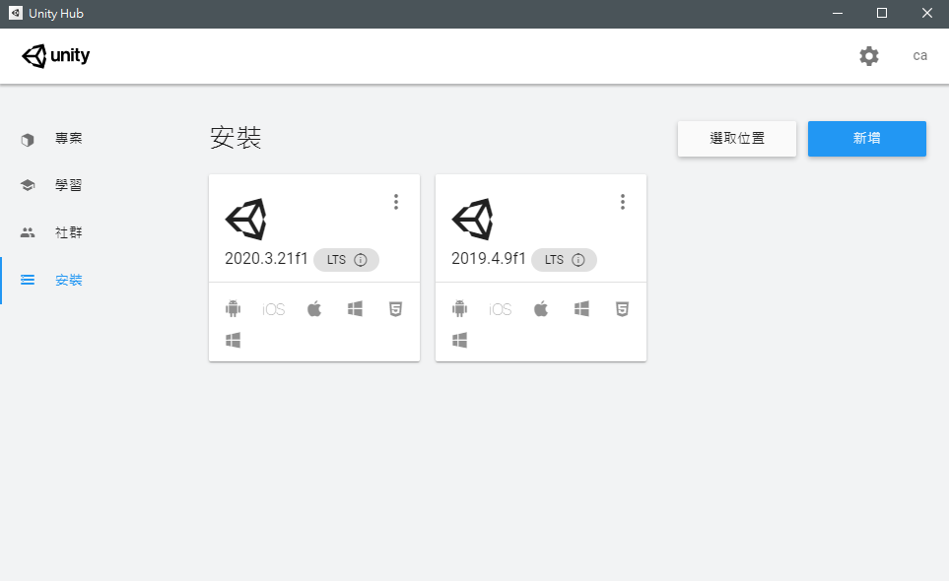
Before Class
Download Unity
After installation…

Slide 13
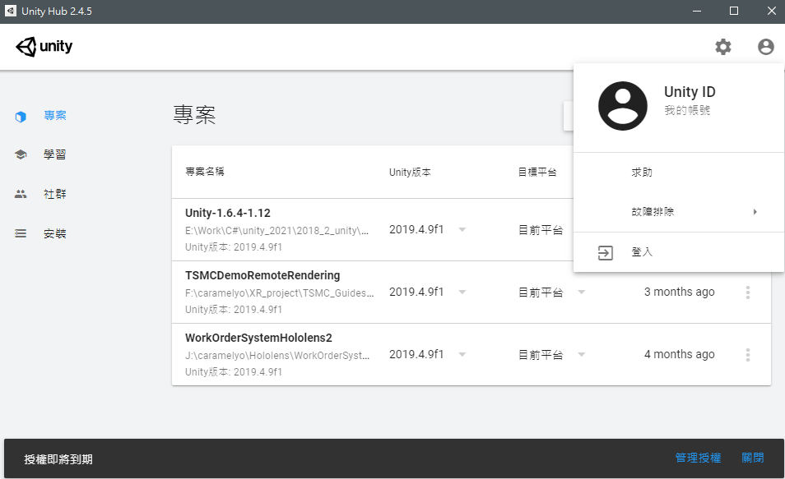
Before Class
Sign in your unity account

Slide 14
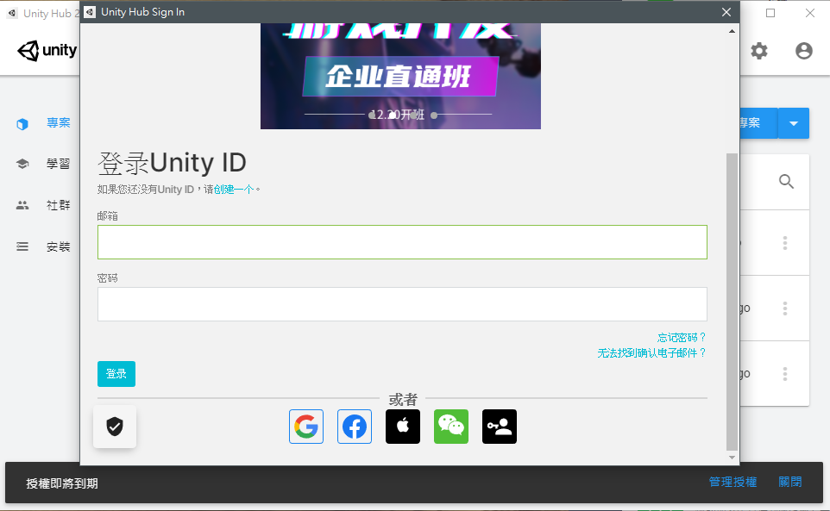
Before Class
Sign in your unity account
If you don’t have it, please sign up first

Slide 15
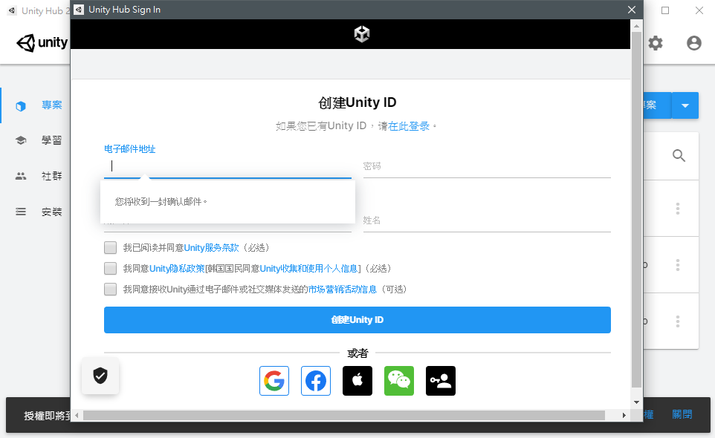
Before Class
Sign in your unity account
If you don’t have it, please sign up first

Slide 16
Before Class
Sign in your unity account
After you sign in…

Slide 17
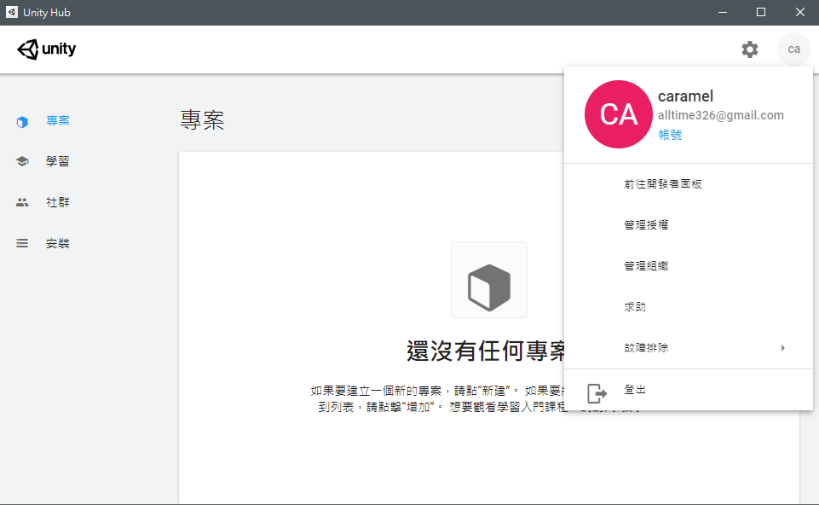
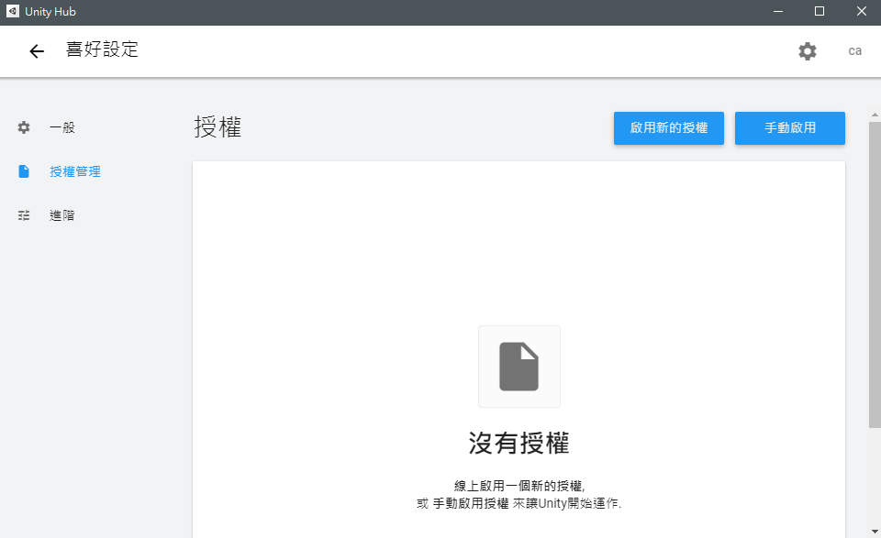
Before Class
Activate your license
If you don’t activate your license…

Slide 18
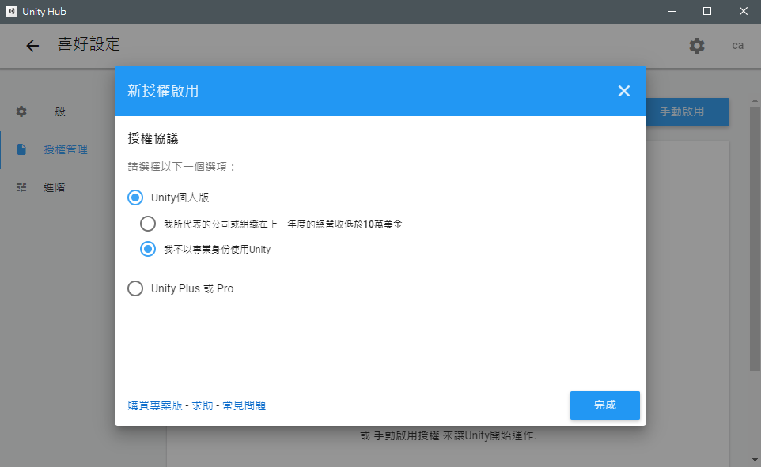
Before Class
Activate your license
Activate…

Slide 19
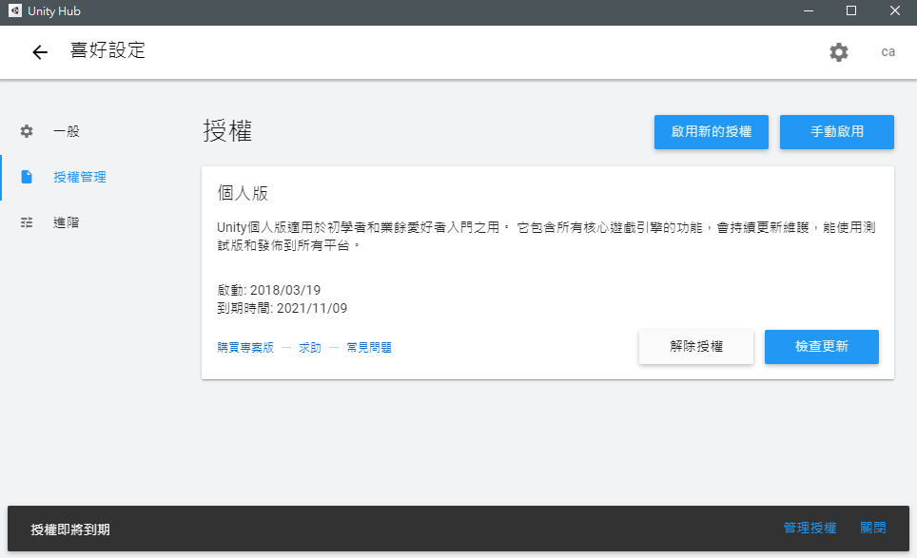
Before Class
Activate your license
3 days only

Slide 20
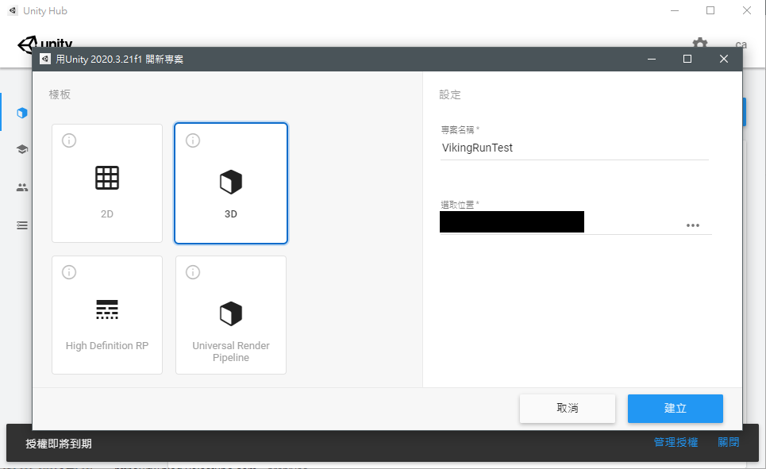
Before Class
New project
Create a new project and wait…

Slide 21
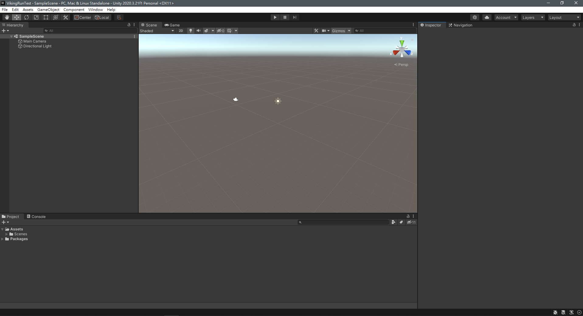
Before Class
New project
Work！

Slide 22
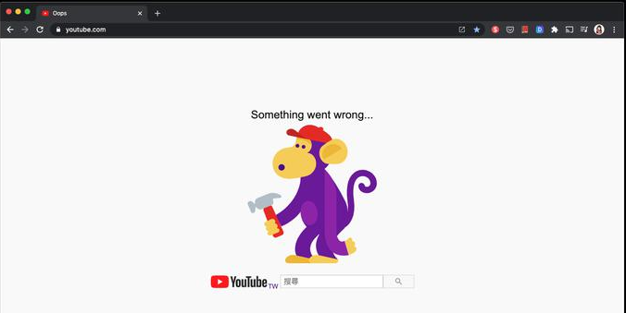
Before Class
What can you do if you cannot log in unity?
Ensure whether the account and password you input is correct
Unity server is under maintenance, so all you can do is to wait

Slide 23
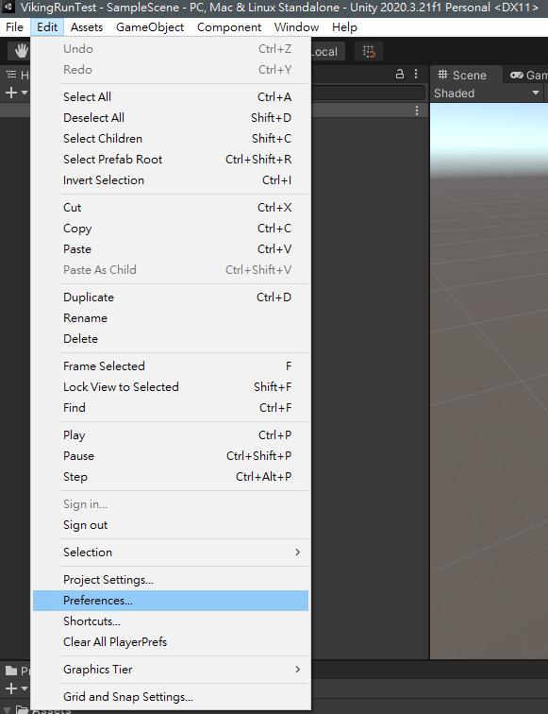
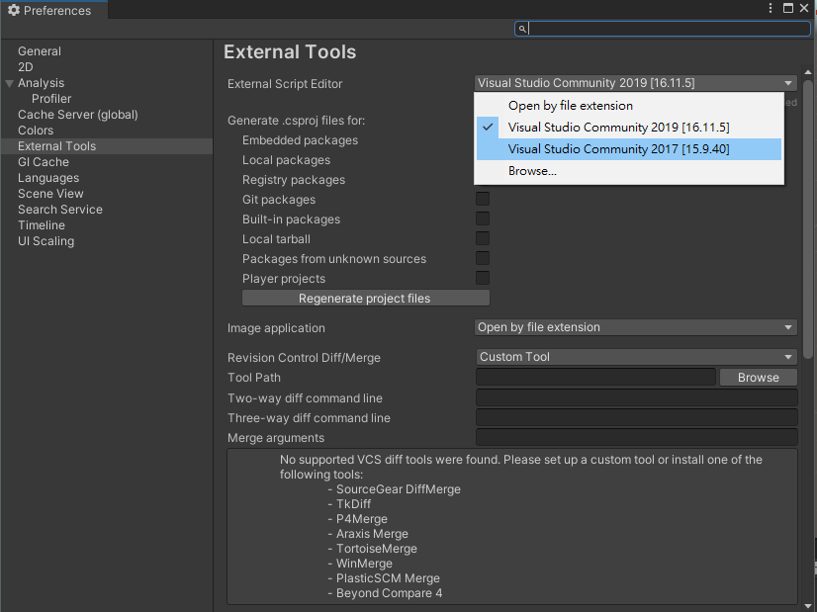
Before Class
Change the script editor into VS 2017
Edit(Top-left) => Preferences => External Tools => External Script Editor => Visual Studio 2017

Slide 24
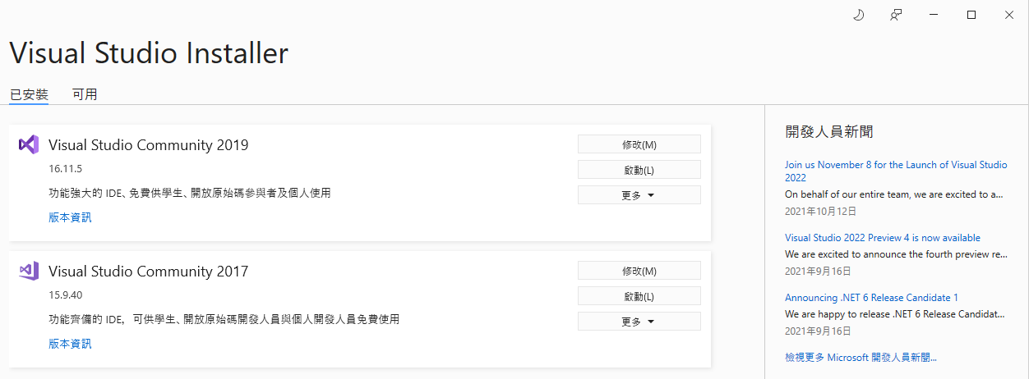
Before Class
Install Unity dependency on VS 2017
Download the VS installer on MS-VS and run it
Modify VS 2017

Slide 25
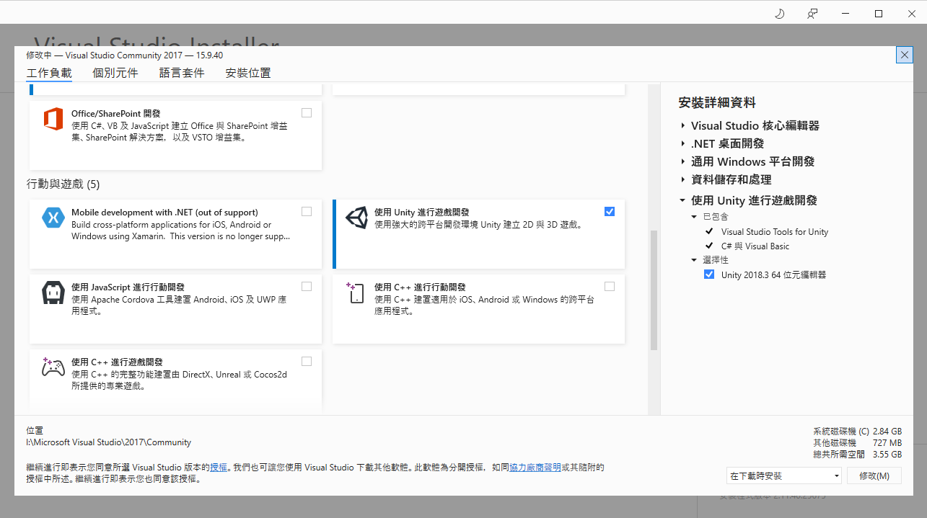
Before Class
Install Unity dependency on VS 2017
Install the Visual Studio Tools for Unity

Slide 26
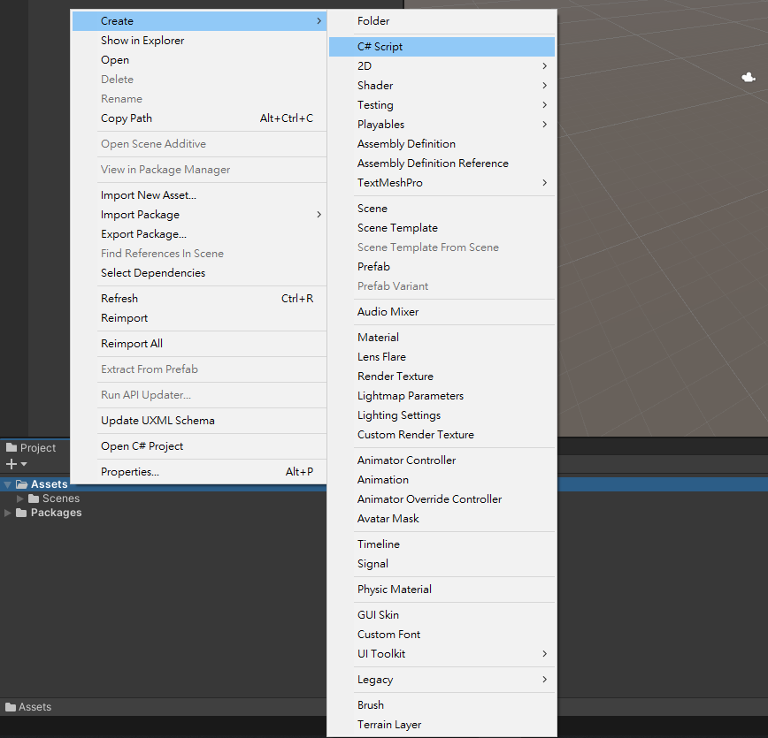
Before Class
New Script
Test script editor
3. Name “Test”
1. In “Project” window
2. Right click

Slide 27
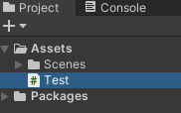
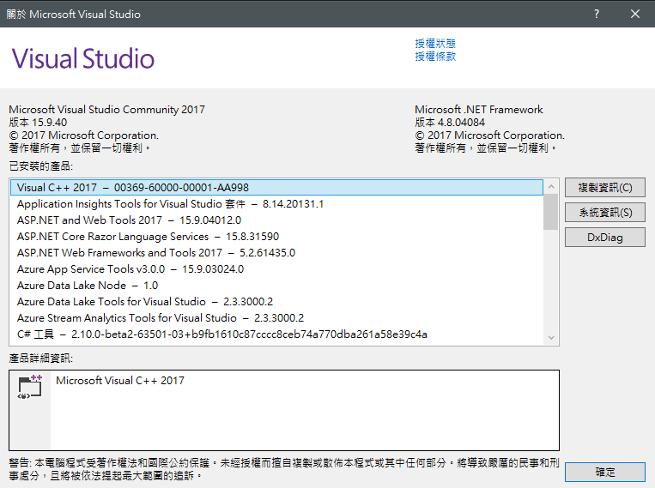
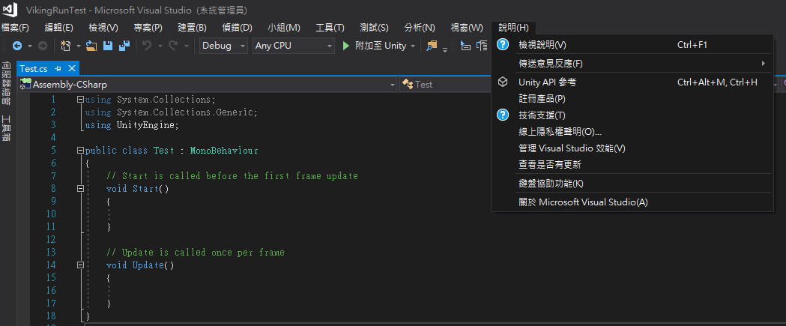
Before Class
New Script
Open the “Test” script
Double click

Slide 28


Outline
Thank you for your listening!

